Slide 1
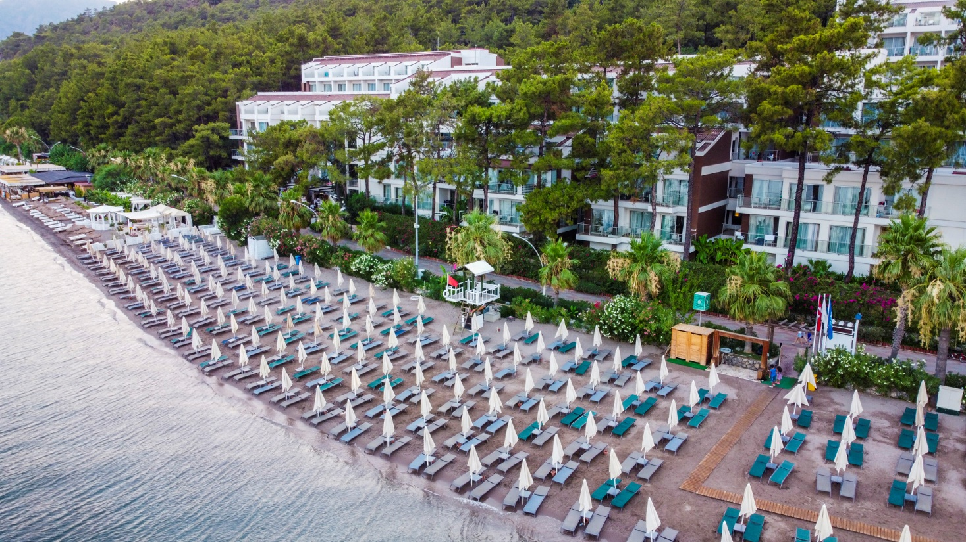

Slide 2
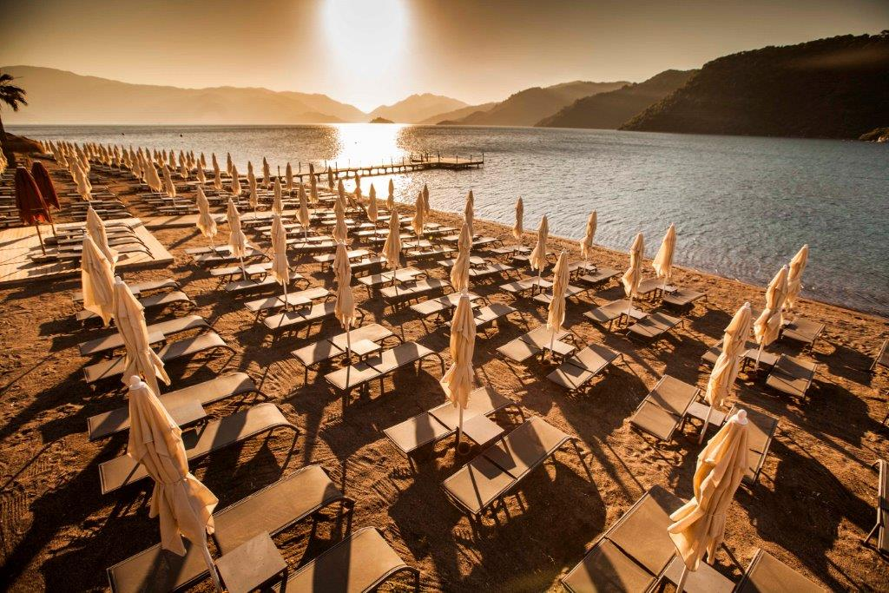
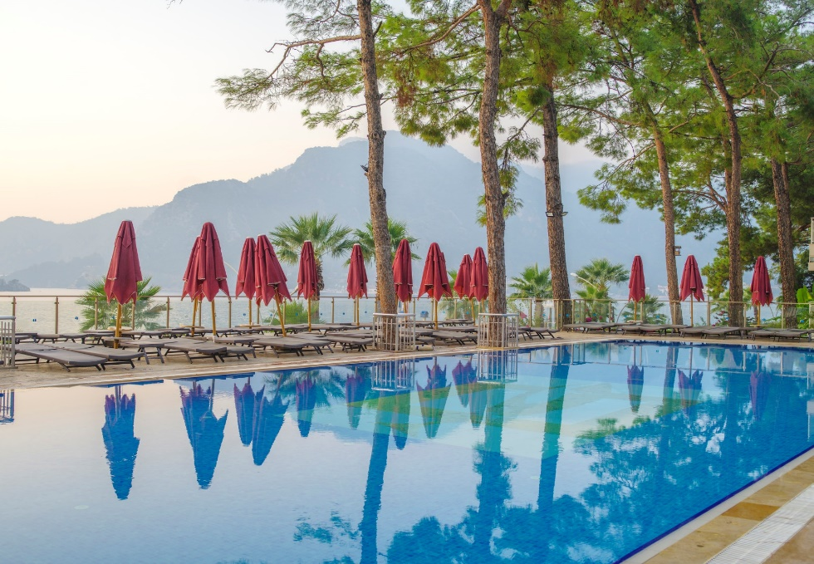
Orka Lotus Beach is located in one of the most exquisite bays of the Aegean where the pine-scented trees and sea-salt meets at Icmeler Pamucak Region. Only 2 km from Icmeler and 6 km from Marmaris. The Property is a chic and sophisticated retreat for couples and families with spectacular views over the bay, delicious dining choices, plenty of activities on site, and 441 comfortable rooms with 5 Star amenities. The unique scenery is also combined with outstanding room facilities, offering you diifferent room type choices. Ultra All Inclusive service, Aqua Park, pools, theme nights, day and evening entertrainment, kids club, international and Turkish Cuisine, A la Carte Restaurants just perfect for guests wishing to kick back relax and bask in endless hours of Turkish sunshine.

Slide 3
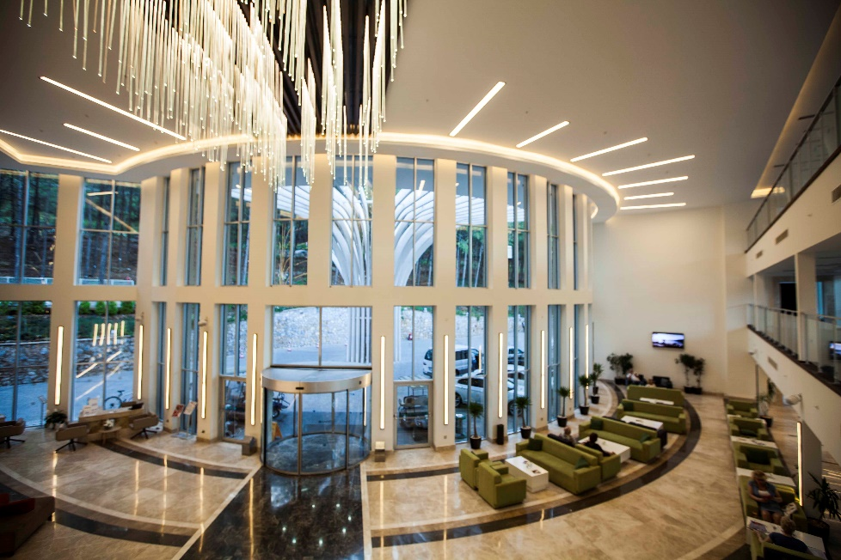
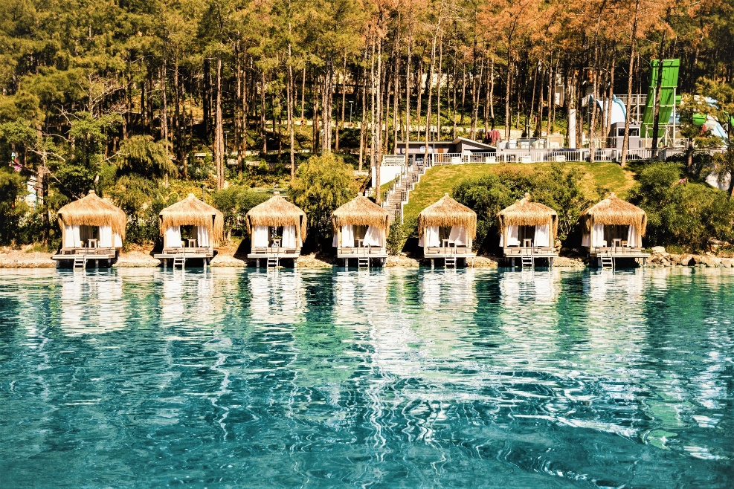
Opening Date | 2015
Category | 5*
Total area | 75.000 m²
Address | İcmeler Mah Ataturk Cd No 56 / 48720 / Marmaris Mugla
Phone | + 90 252 455 50 50
Fax | + 90 252 455 50 65
E-mail | info.orkalotus@orkahotels.com
Web Site | https://www.orkalotusbeach.com/
Dalaman Airport Bodrum Airport | 90 km. 150 km.
Marmaris Center İçmeler Center | 6 km. 2 km.
Distances | Dalaman Airport 90 Minutes Bodrum Airport 150 Minutes
Places of interest | Hisarönü,Selimiye,Turgut,Turunc,Kumlubük, Orhaniye,Kaunos,Dalyan,Efes,Pamukkale, Rodos( by ferry from Marmaris Centrum)
Beach Location and Length | Front of the facility. 1 km – Private Sandy Beach
Number of Buildings & Rooms | 9 Blocks - 441 Rooms – 1138 beds
Internet | Free – Wifi
Car Parking | Free - Open Air Car Park Area is Available
Concept | All Inclusive | Open Buffet Breakfast, Lunch and Dinner, Late Breakfast, Alcoholic and non Alcoholic Beverages, selected imports, Lobby Bar (24 Hrs), A la Carte Restaurants, Tea Time With Cookies, Snacks, Ice Cream (Selected Hours), Daily Refreshed Minibar with Soft Drinks, Free Car Park and Vallet Parking Services.

Slide 4
Total number of rooms: | 441
Total number of beds: | 1138
 | Promo Room No view | Standard Land View | Standard Side Sea View | Standard Sea View | Large Side Sea View | Large Sea View | Family Land View | Family Sea View | Family Side Sea View
Number of rooms | 48 | 115 | 58 | 78 | 29 | 48 | 30 | 31 | 4
 | Promo Oda manzarasız (24 m²) | Standart Kara Manzaralı (20 26 m²) | Standart Kısmen Deniz (26 m²) | Standart Deniz Manzaralı (26 m²) | Geniş Oda Kısmi Deniz Manzaralı (30-34m²) | Geniş Oda Deniz Manzaralı (36m²) | Aile Odası Kara Manzaralı (36 (36– 40 m²) | Aile Odası Deniz Manzaralı (36 – 40 m²) | Aile Odası Kısmi Deniz Manzaralı (36 - 40 m²)
Pillows Menu | X | X | X | X | X | X | X | X | X
Minibar | X | X | X | X | X | X | X | X | X
Tea - Coffee amenities | X | X | X | X | X | X | X | X | X
Led TV | X | X | X | X | X | X | X | X | X
Safe Box | X | X | X | X | X | X | X | X | X
Wifi | X | X | X | X | X | X | X | X | X
Central Air Conditioning | X | X | X | X | X | X | X | X | X
Hair Dryer | X | X | X | X | X | X | X | X | X
Balcony/Terrace | NO | X | X | X | X | X | X | X | X
No Balcony | X
Telephone | X | X | X | X | X | X | X | X | X
Slippers | X | X | X | X | X | X | X | X | X
Kids Slippers | X | X | X | X | X | X | X | X | X

Slide 5
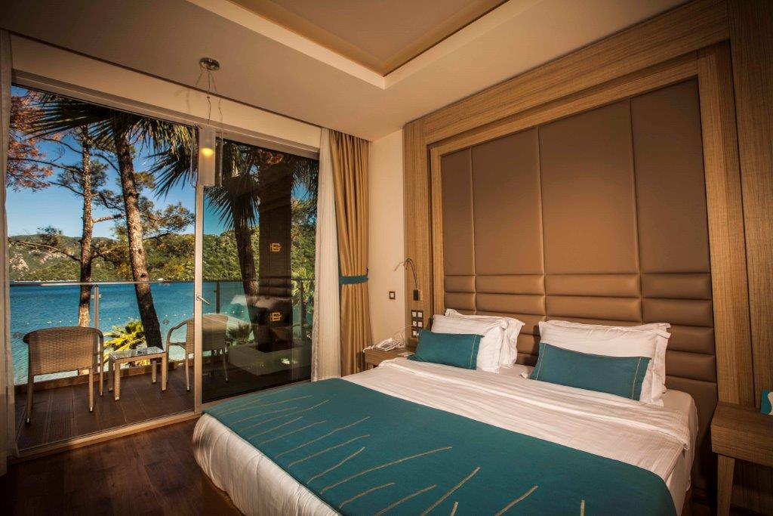
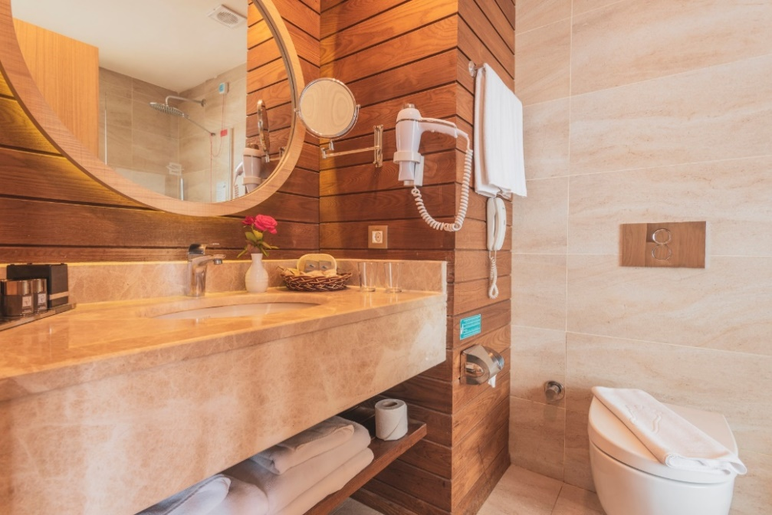
ROOMS
 | LOCATION | SIZE | FEATURES
Standard Rooms | Main Building & Blocks | 20 & 26 m² | With the options of sea, side sea or land view, Mini bar (Daily filled with water, mineral water), LED TV, satellite, wireless & cable fast internet connection, water heater, tea & coffee options, direct line telephone, central air conditioning, safe box, terrace or balcony, reading lamp, laminated flooring, rain shower/WC, make up mirror, hair dryer in the bathroom, slippers and special design bathroom amenities.
Large Rooms | Main Building & Blocks | 36 m² | With the options of sea or side sea view, Mini bar (Daily filled with water, mineral water), LED TV, satellite, wireless & cable fast internet connection, water heater, tea & coffee options, direct line telephone, central air conditioning, safe box, terrace or balcony, reading lamp, laminated flooring, rain shower/WC, make up mirror, hair dryer, slippers and special design bathroom amenities.
Family Rooms | Main Building & Blocks | 36-40m² | With the options of sea, side sea or land view, Mini bar (Daily filled with water, mineral water), LED TV, satellite, wireless & cable fast internet connection, water heater, tea & coffee options, direct line telephone, central air conditioning, safe box, terrace or balcony, reading lamp, laminated flooring, rain shower/WC, make up mirror, hair dryer in the bathroom, slippers and special design bathroom amenities (Includes 2 rooms + 1 bathroom).

Slide 6
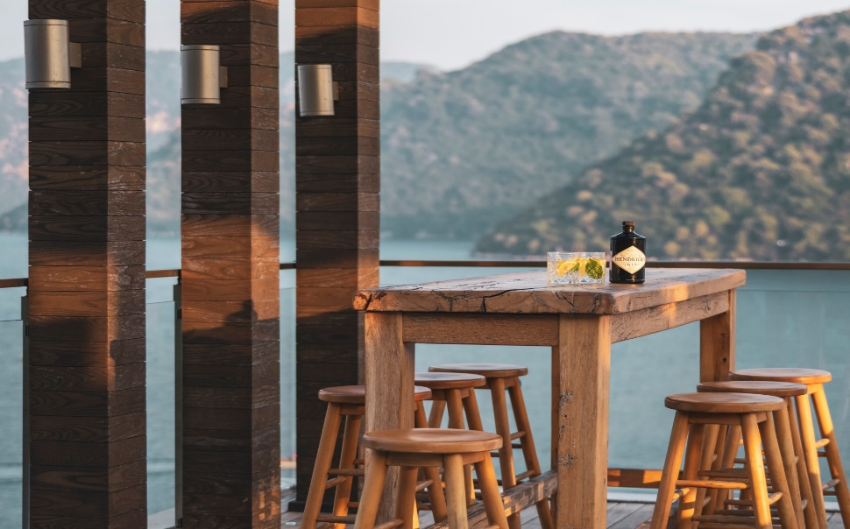
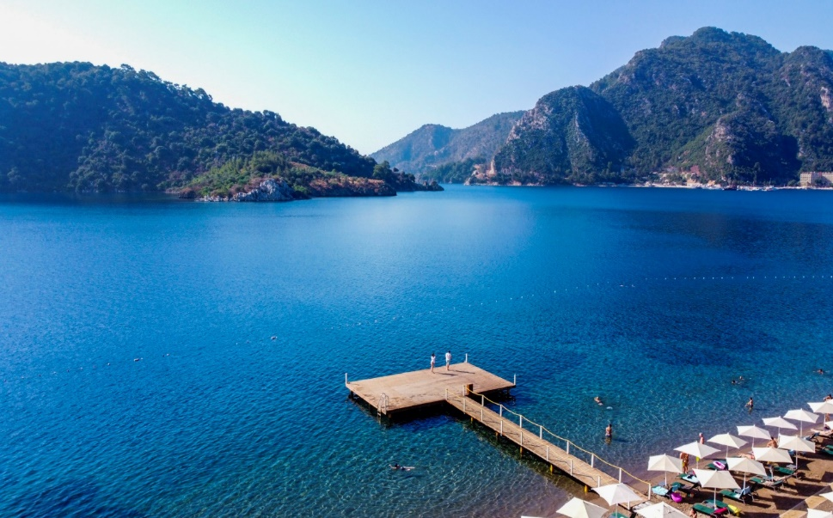
A la Carte Restaurants: Chinese (extra pp.15 euro), Italian (extra pp.15 Euro Turkish (extra pp.10 Euro)
Bars (Lobby, Patisseria, Relax, Tapas, Beach, Blue, Vitamin, Aqua)
Aquapark for Adults and Children with 6 Different Slides
Outdoor 4 pools +1 kids pool
Indoor Pool + 1 kids pool
Pavillions (extra)
Day And Evening Entertainment
Live Music
Water Gym
Holiday Concierge
Dart
Beach Volleyball
Table Tennis
Meeting Rooms
Kids Splash Pool
Sun Terrace
Wi-Fi (limited)
TV Corner – Teenage Play Room
Disco
Mini Disco
Mini Club
Baby Sitting (extra)
Car Parking
Library
Spa Center
Shopping Arcade
Water Sports

Slide 7
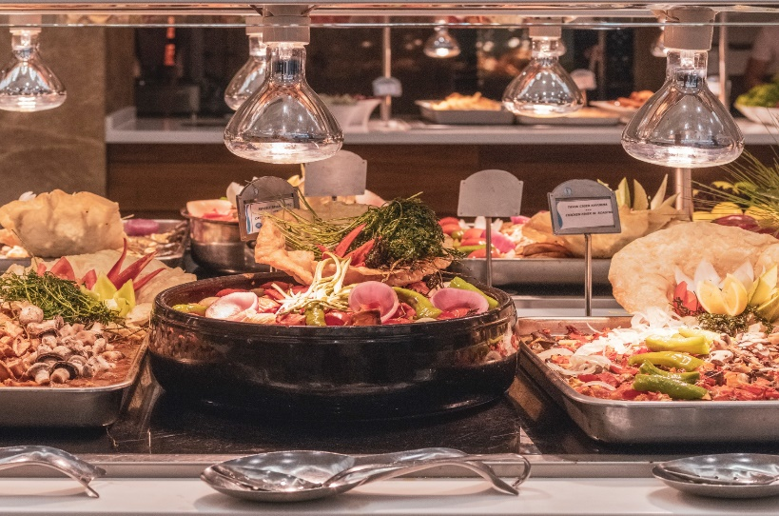
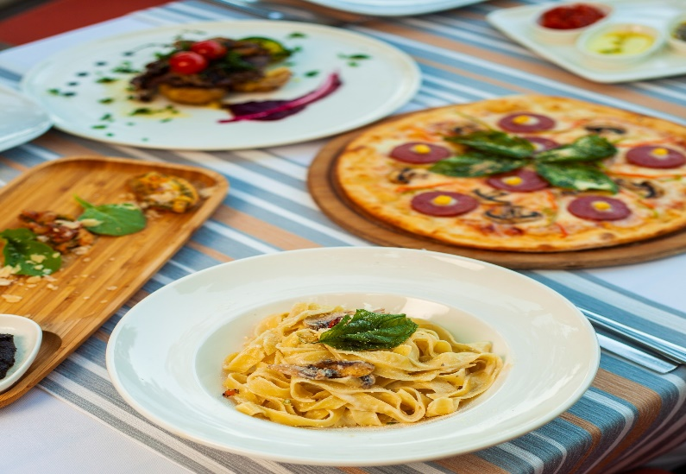
Included Services
Services With Extra Charge
Open Buffet Breakfast, Late Breakfast, Lunch, Dinner, Night Snack
Local & Selected International Beverages
A la Carte Restaurants (Italian-Turkish) – (With Reservation once per week)
Snacks
Minibar ( Beer and beverage by arrival, water+mineral as daily)
Safe Box in Room
All A la Carte reservations
High Quality wines, choice of imported drinks and Bottled Beverages
Room Service-24h
Laundry Service
Water Sports ( Jet sky, Banana, Pedaloes, Ringo, Parasailing etc.)
24 hrs Lobby Bar
Patisseria :Tea – Coffee and different kind of specified cakes
Ice Cream ( specified hrs)
Speacial Treatments for Honeymooners and Couples who are Celebrating Anniversary %25 discount pavillion, plus one additional alacarte attendance and priority for reservations
All Animation Activities & Entertainment Programs
All Shops & Hairdresser / Beauty Salon
Diving Center
Telephone & Fax
Speacial Orders
Spa Center & All Types of Treatments
Pavillions on the beach
Mini Club & Kids Animation
Turkish Bath & Sauna & Steam Bath
Wi-fi
Beach Towels & Sunbeds
Baby Sitting

Slide 8
BARS
 |  |  | Explanation | Opening Hours | Paid | Booking
Lotus Lobby Bar |  | Waiter Service | Local &Selected International Beverages | 24 Hrs
Tapas Pool Bar |  | Self Service | Local Beverages | 10:00 -18:00
Aqua Snack Bar |  | Self Service | Local Beverages | 10:00 -24:00
Blue Bar |  | Waiter Service | Local & Selected International Beverages | 18:00 - 01:00
Beach Bar |  | Self Service | Soft Drinks and Beer | 10:00-18:00
Relax Bar |  | Self Service | Soft Drinks and Beer | 10:00-17:00
Patisserie |  | Waiter Service | Hot Beverages | 11:00-18:00

Slide 9
RESTAURANTS
 |  |  | Explanation | Opening Hours | Paid | Booking
PINE MAIN RESTAURANT |  | Main Restaurant Buffet Service | Local Beverages | Breakfast 07:00-10:30 Late Breakfast 10:30-11:30 Lunch 12:30-14:30 Dinner 19:00-21:30 Night Buffet 23:30-01:00
 |  | A’la Carte service (extra pp.15 Euro) | Italian Cuisine | 19:00- 21:30 | x | x
Arena |  | A’la Carte service (extra pp.15 Euro) | Chinese Cuisine | 19:00 -21:30 | x | x
 |  | A’la Carte service(extra pp.10 Euro) | Turkish Cuisine | 19:00-21:30 | x | x

Slide 10
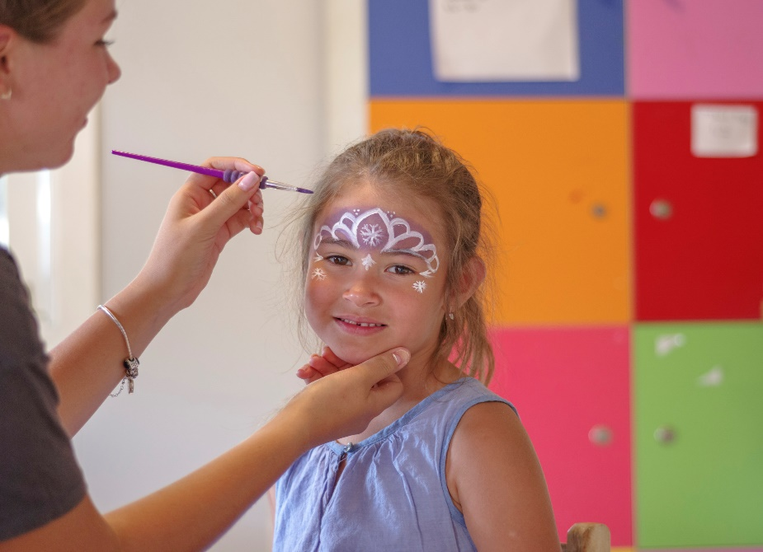
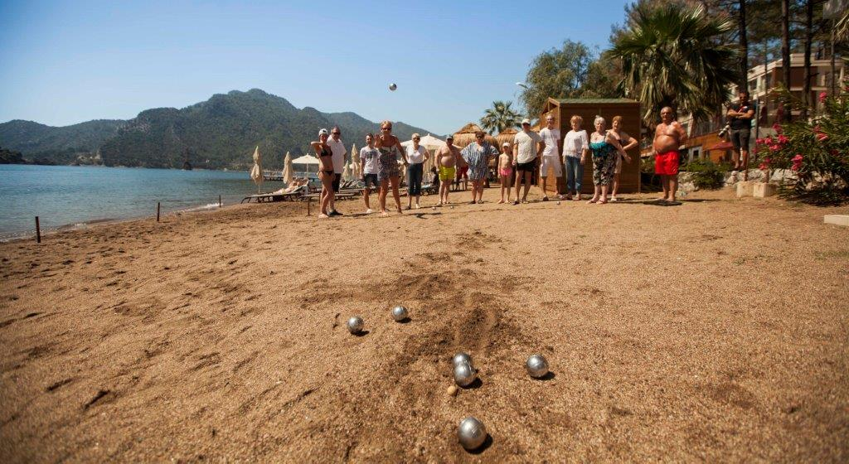
ENTERTAINMENT & ACTIVITIES

Slide 11
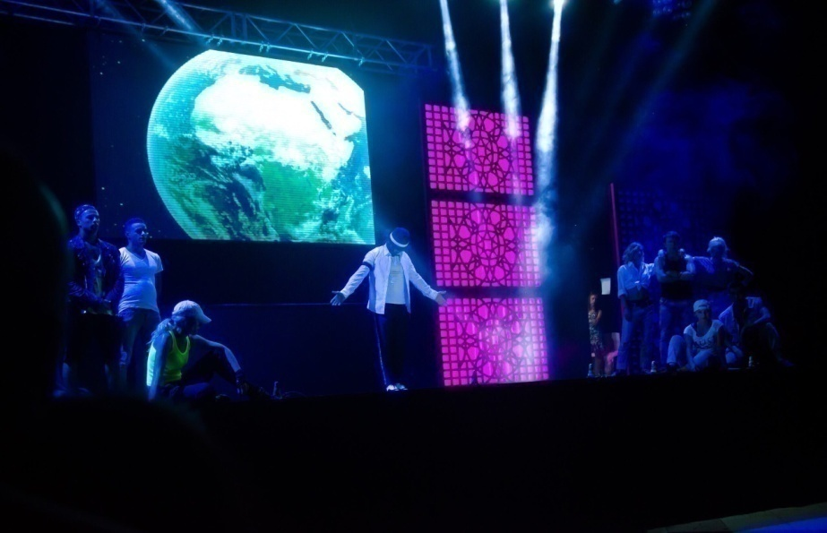
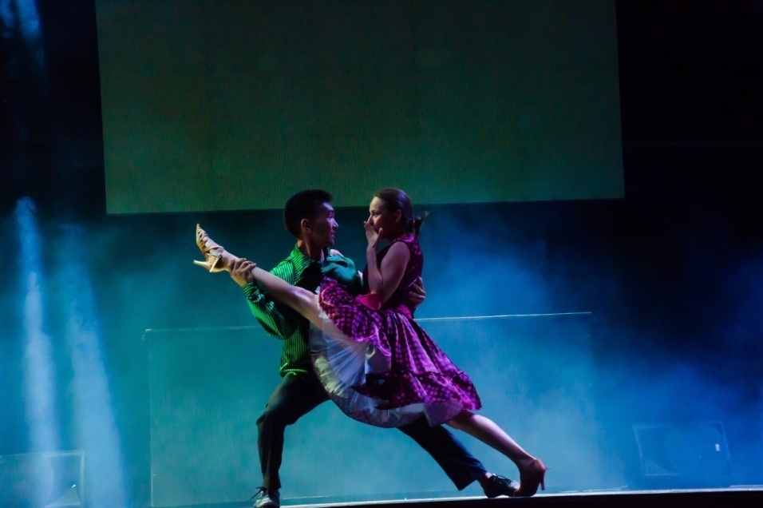
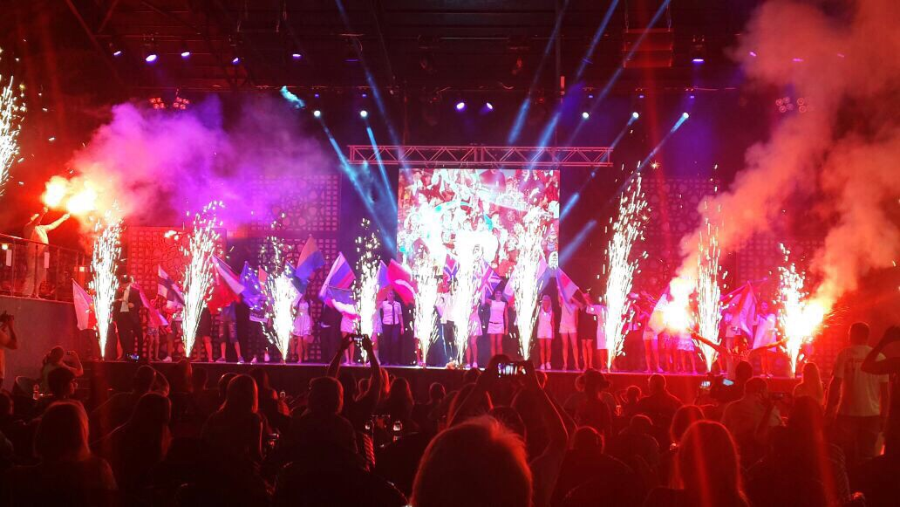
ENTERTAINMENT & ACTIVITIES

Slide 12
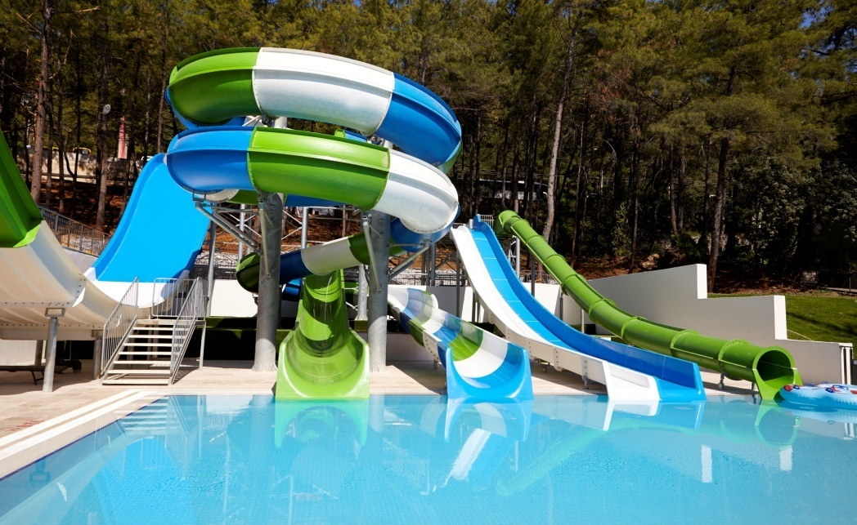
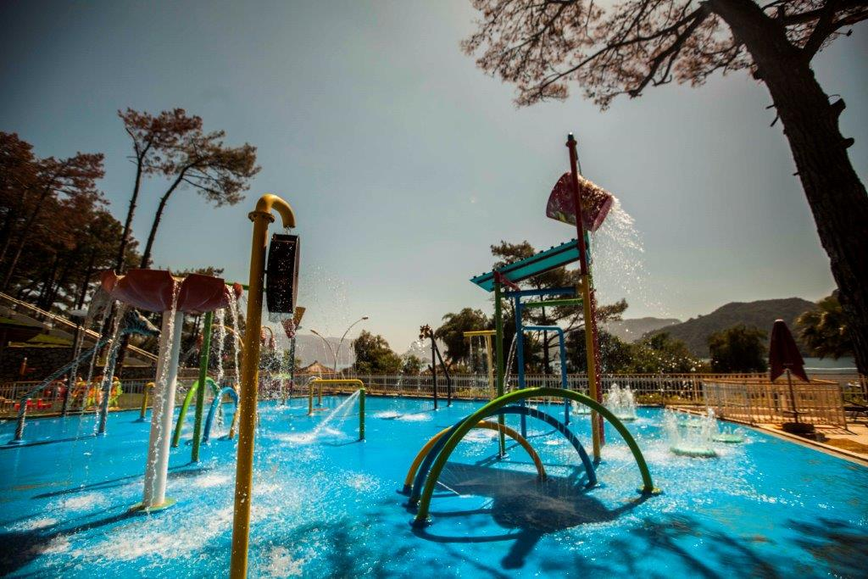

Slide 13
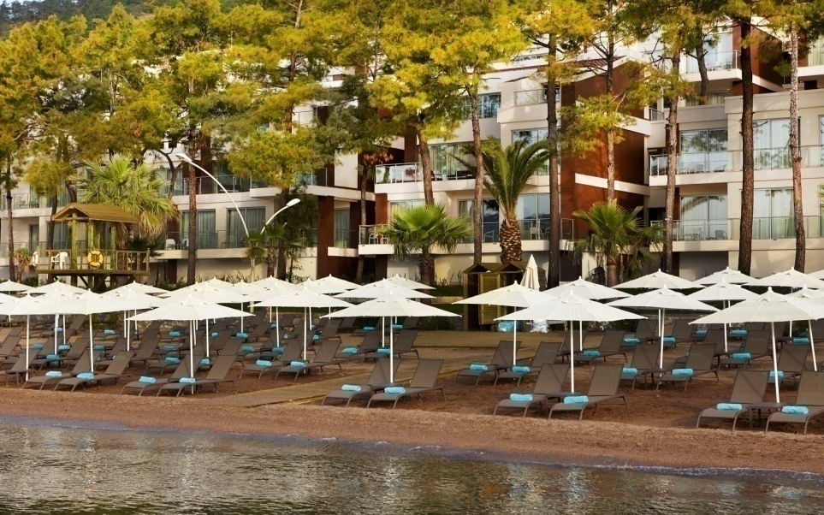
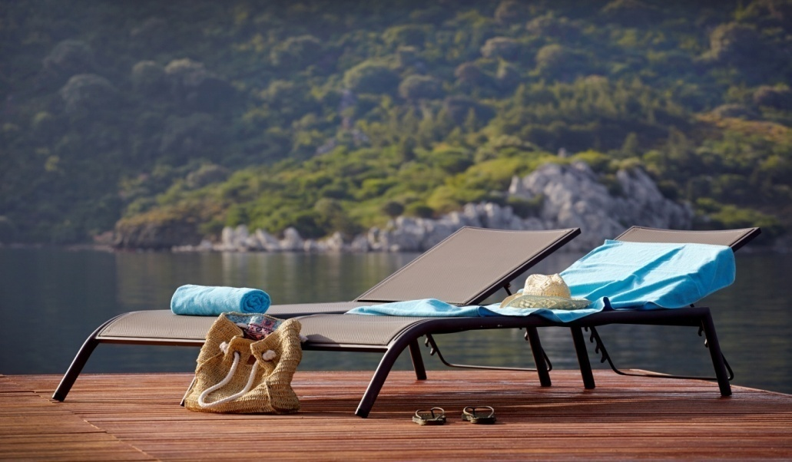
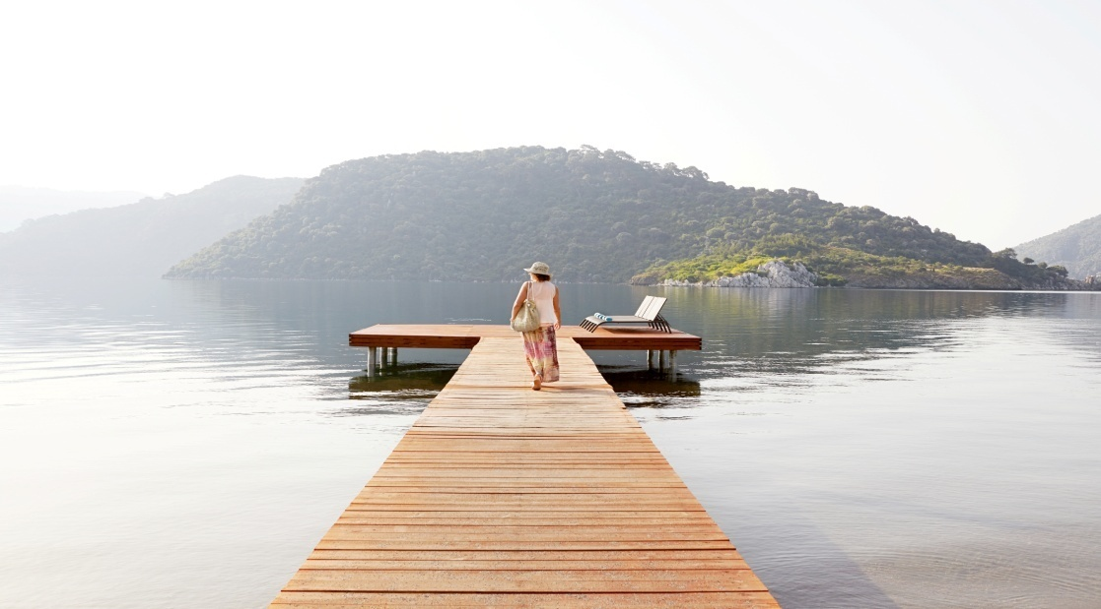

Slide 14
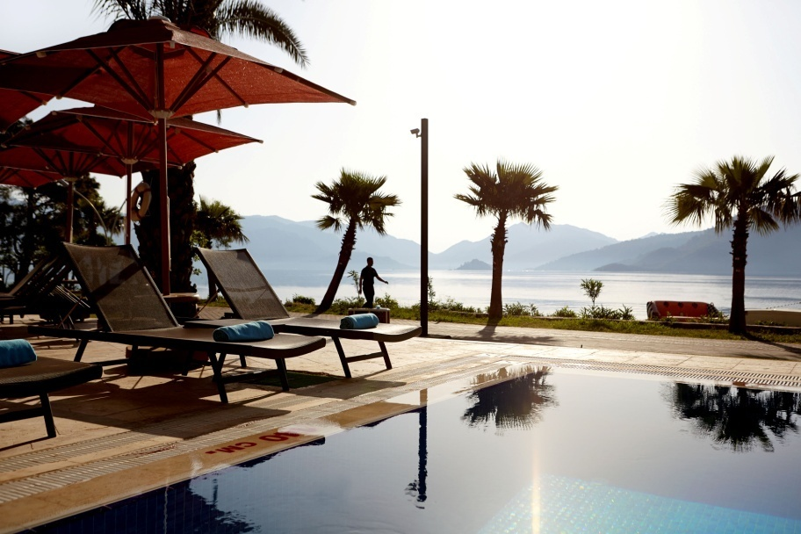
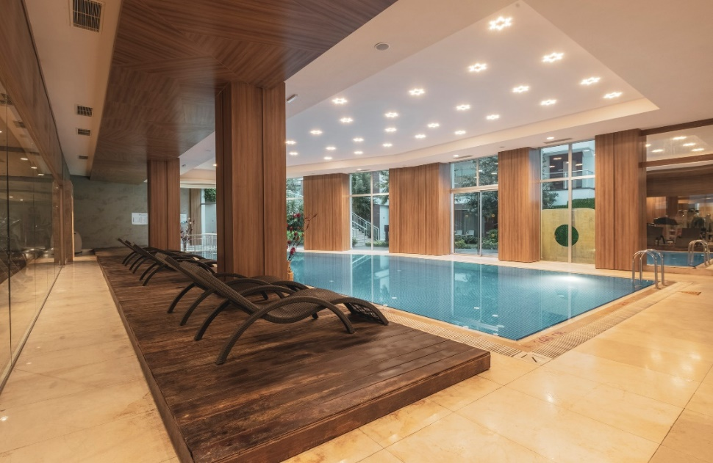

Slide 15
NOTES
Check-in is after 15:00 and check-out is before 11:00. Early check-in available between 05:00 and 09:00 depending on the availability of the rooms (paid), and early check-in before 05:00 is full-day charged. Late check-out is available till 16:00 or 20:00 depending on the availability of the rooms (paid).
Swimming pools and Beach may withdraw their services depending on the weather conditions.
Pursuant to the Law Number 4207 on Using Tobacco and Tobacco Products; smoking and water pipe are not allowed in indoor spaces.
Service hours and areas of the outdoor units (restaurants-bars) are subject to change in low season and entertainment programmes may vary or to be cancelled depending on the weather conditions.
Introduction letter must be approved by the hotel management before hotel details are published (on catalogues, magazines, ads etc.). All documents provided without a prior consent shall be under responsibility of the parties that distribute such documents and details. Facility denies responsibility.
The hotel management is authorised to make modifications, cancellations and change of areas regarding the facility info in a significant timeframe; Modifications on printed information are evaluated by the publishing party. Due to Covid - 19 hotel management has the right to make any changes to the concept.
WARNING:
Orka Lotus Beach reserves the right to make modifications on the concept, without having to provide information to the third parties and/or institutions in advance

